Slide 1
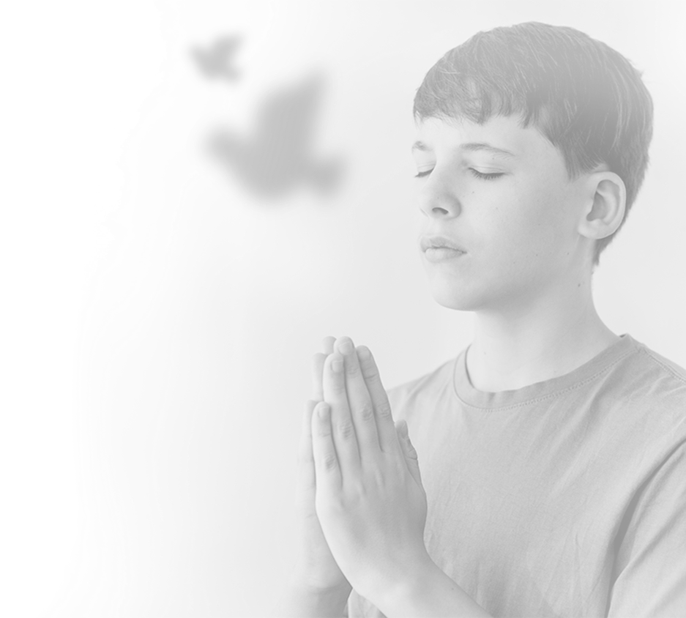
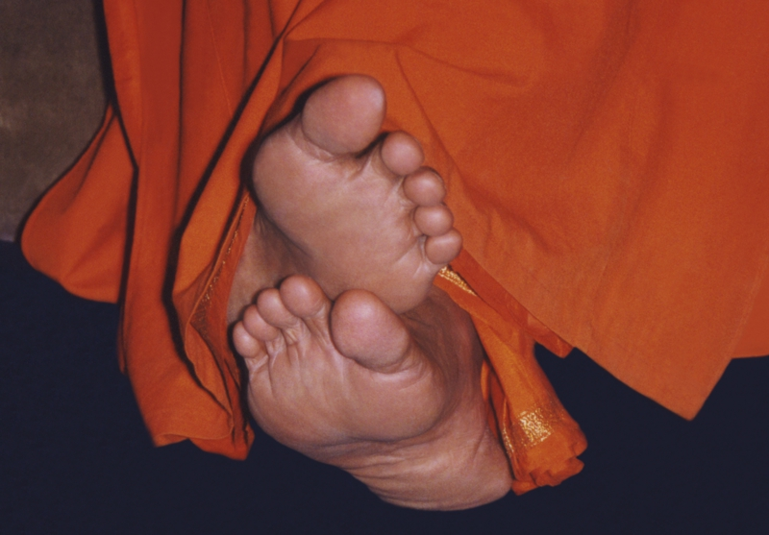
Offering Our Humble Pranam
To Our Beloved Bhagwan

Slide 2
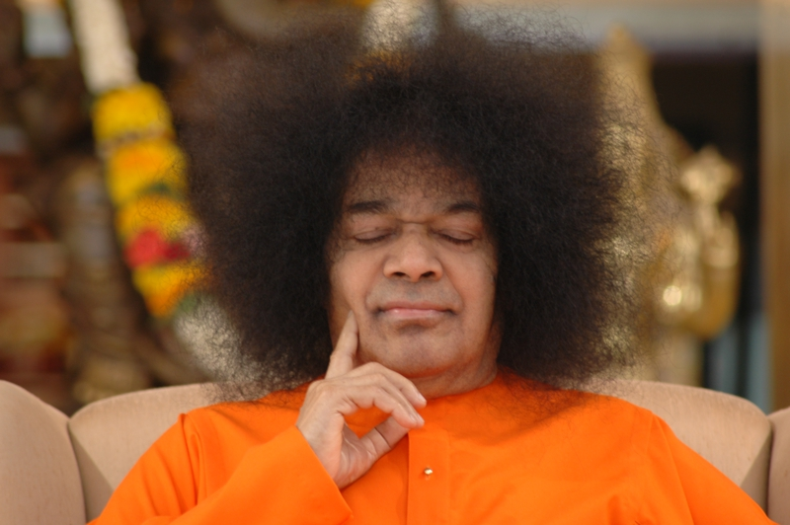

Slide 3

From Cape To Kilanmarg
Baba encourages everyone to appreciate the beauties of nature; He directs attention to the charm of a flower, the colourful magnificence of a sunrise or sunset, the grim grandeur of an overcast sky, the timorous twinkling of the stars in the midnight sky or the moving jasmine-garland of cranes in flight

Slide 4
All-India Divine Life Convention
Venkatagiri
It was landmark in
the Dharmic campaign of Bhagawan, for He presided over the deliberations and sounded the
clarion call of sadhana and spiritual regeneration.

Slide 5
Saints who were present at that moment
Satchidananda
Atmaswarupananda
Sadananda
Sivananda

Slide 6
Presidential Speech by Swami

Slide 7
Divine Life is the rain that falls from the clouds of Sathya, Prema, and Ahimsa. It comprises all acts done in pursuit of the Reality, to attain the Reality behind this illusive variety. "Divinity," He said, "is inherent and immanent in every individual as butter in milk. Just as we churn milk to separate the butter, man must churn his mind with good deeds and good company.

Slide 8

Bhagwan is always the rescuer of his devotees

Slide 9
Tapovana
29th of June, 1957. Swami Satchidananda said that, whatever others may take Baba to be, he was convinced from personal experience that He was "Chidghanamurti," "Sarvagnya," "Sarvaantaryamin," and "Sarvabhootantaratma."

Slide 10
“ Don’t worry the Instrument is with me, Baba”

Slide 11
Kanyakumari-

Slide 12
Periyar Dam

Slide 13
Madurai

Slide 14

Mayuram

Slide 15
Salem

Slide 16
Tirupati

Slide 17

Puttaparthi

Slide 18
Medkurti

Slide 19
Mr.S.S.Baba!

Slide 20
Haridwar

Slide 21
Rishikesh
Baba's cottage at Rishikesh was busy throughout His stay, with the inmates of the Ashram and the students of the Academy gathering there and plying Him with questions on sadhana, japa, and dhyana, and the unceasing train of pilgrims who discovered that Rishikesh had acquired another focus of Holiness.

Slide 22
Shivanandanagar
Shivanandanagar nestles on the lap of evergreen mountains, fondled lovingly by the kindly right arm of Mother Ganga. The left bank of the river, when it comes into view occasionally as the curtain of mist is wafted away by a passing wind, is resplendent with a line of temples, mutts, and edifices housing the Gita Bhavan, the Swargashram, the Paramartha Niketan, etc. But, more impressive than these reminders of Man's inborn home-sickness are the forest-clad mountains on every side, that seem like superhuman sages lost in silent contemplation of the Infinite. They have averted their eyes inward and are blissfully unaware of history!

Slide 23
Vashishthaguha

Slide 24
Swami Purushotamananda
Swami Purushotamananda, a disciple of Swami Brahmananda of the Ramakrishna order, initiated into sanyas by Mahapurushji, another direct disciple of Sri Ramakrishna, who had been in the cave since 30 years, welcomed Baba as if he too was expecting Him! He was more than seventy years old and he had spent the major part of his life in asceticism of a most rigorous kind and in the study of scriptures. His face had the genuine glow of spiritual joy and the slightest mention of the glory of Godhead sent him to samadhi.

Slide 25
Swami Kalikananda “Sri Raghuvara Sugunalaya!”

Slide 26
Sri Subbaramaiah

Slide 27


Slide 28
Swami Sadananda said – Atmaloka Pranaloka Jivaloka

Slide 29


Slide 30

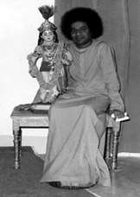
Radha-Shyam Temple

Slide 31
Shankaracharya Mutt-Srinagar

Slide 32


Alexandra Palace

Slide 33
Shalimar

Slide 34
Nishat Bagh Garden

Slide 35
Sarvaantaryami

